Slide 1
Field Effect Transistor (Alan Etkili Transistör) MOSFET
Metal-Oxide-Semiconductor
Field Effect Transistors

Slide 2
Alan Etkili Transistör Field Effect Transistor (FET)
FET
JFET – Junction Field Effect Transistor:
n-channel
p-channel
MOSFET – Metal-Oxide-Semiconductor Field Effect Transistor:
Enhancement-type (Kanal Oluşturmalı):
n-channel (NMOS)
p-channel (PMOS)
Depletion-type (Kanal kısılmalı ya da ayarlamalı):
n-channel
p-channel

Slide 3
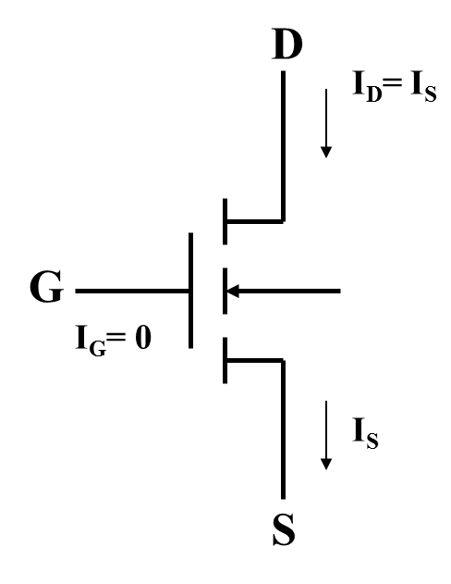
MOSFET
BJT is a current controlled element, MOSFET is a voltage controlled element.
MOSFET has "gate", "Drain", "Source" and "Body" terminals.
G-Gate (Kapı)
D-Drain (Savak)
S-Source (Kaynak)
B-Substrate or Body (Gövde)

Slide 4
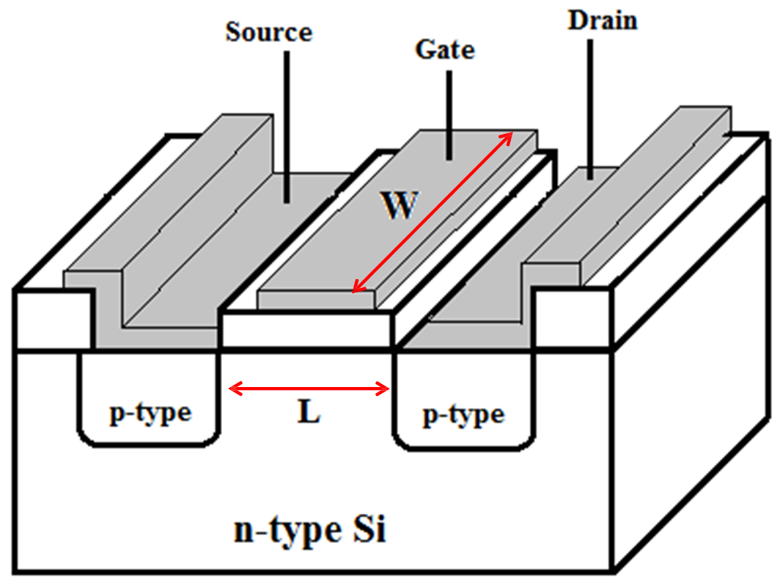
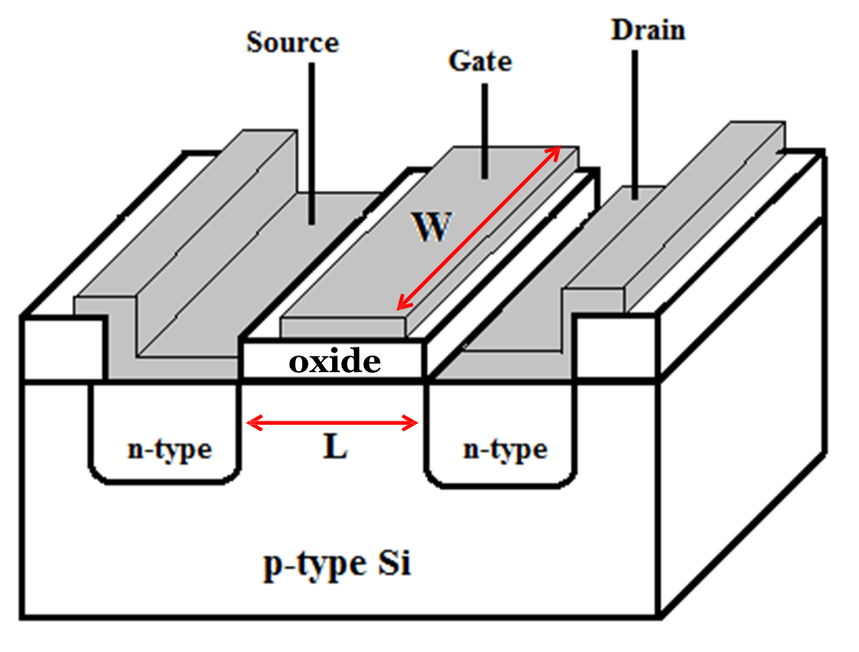
Cross-Sectional View of n channel Enhancement Mode Transistor
MOSFET
Cross-Sectional View of
p channel Enhancement Mode Transistor
A voltage (at least equal to the threshold voltage) must be applied to the gate of the transistor to create a conduction path between the source and the drain of the transistor.

Slide 5
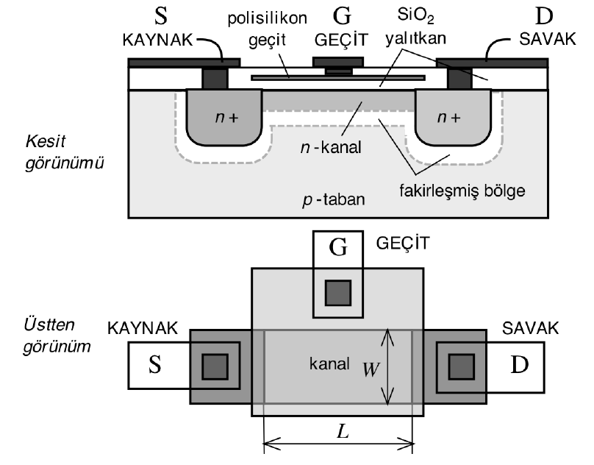
MOSFET
MOSFET (Metal Oxide Field Efect Transistor) is today the most widely used active elements, especially in digital electronic circuits.
The MOS transistor is performed on a substrate (body) made of n or p type semiconductors.
If P-type substrate is used, n-channel MOS is obtained as in the figure.
In n-channel transistors, source and drain connections are obtained by creating over-doped n+ regions.
Poly-silicon (polysilicon) semiconductors acting as conductors are also used as the gate electrodes.

Slide 6
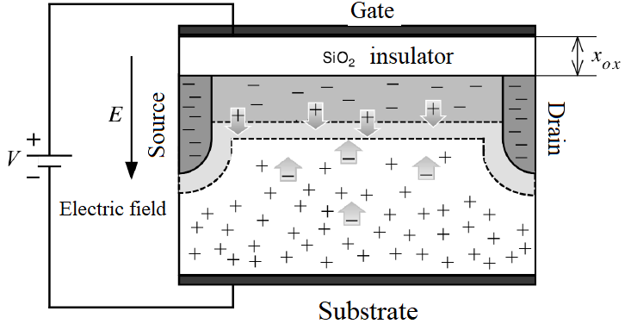
The Operation of Metal Oxide Field Efect Transistor (MOSFET)
Field effect transistor is based on controlling the current through a channel whose conductivity changes with the effect of electric field..
Normal MOSFET transistors work on the channel creation principle. In other words, if no voltage is applied to the gate, there is no channel and no current flows between drain and source terminals.
In the n-channel MOSFET shown in the Figure, when positive voltage is applied to the gate, the holes under the gate are removed from this region by the effect of the electric field. A depletion region is formed in the chanel region.
The formation of the channel

Slide 7
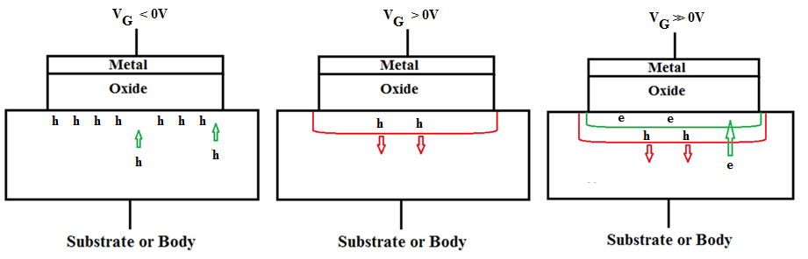
Field Effect Transistor Operation
Accumulation (Yığılma) Depletion (Fakirleşme) Inversion (Evirtim)
The value of VGs at which a sufficient number of mobile electrons accumulate in the channel region to form an conducting channel is called treshold voltage.

Slide 8
Threshold Voltage
One of the most important parameters of the MOS transistor is the threshold voltage VTN.
The value of VTN is controlled during device fabrication and typically lies in the range of 0.3-1 V .
The gate voltage when the negative charge density is equal to the previous hole density is called the threshold voltage and is indicated by the Vth symbol.

Slide 9
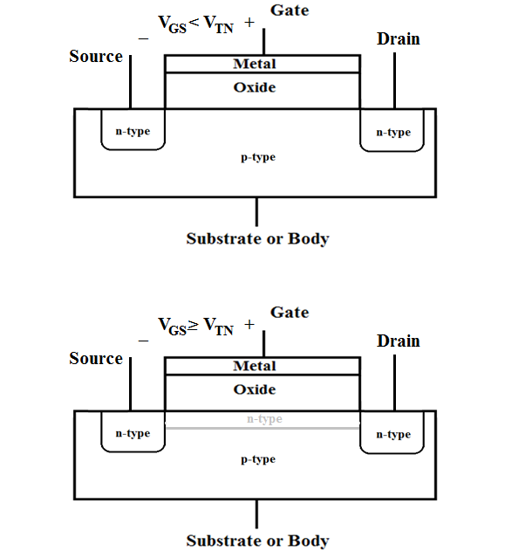
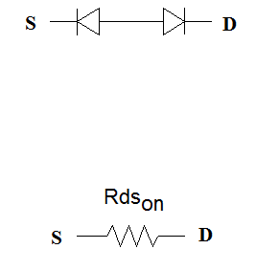
N- type Enhancement MOSFET
Before the channel is formed
After the channel has been formed

Slide 10
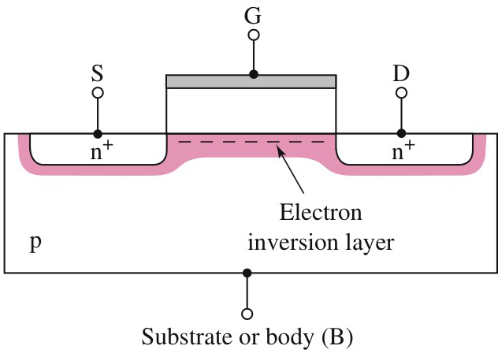
N- type Enhancement MOSFET
A voltage is required to create the transmission path, so the MOSFET is called Enhancement type MOS.
The carriers in the transmission path are electrons - so n-channel is called NMOS.

Slide 11
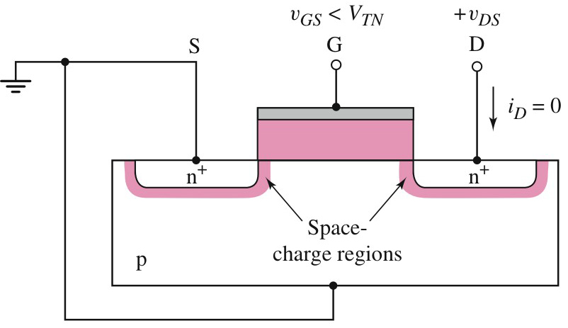
N- type Enhancement MOSFET
To create a transmission path, the gate-source voltage (VGS) must be above a minimum value known as the threshold voltage (VTN) which is positive for NMOS.
Without the transmission path, the current in the circuit is actually zero.
v_{GS} < V_{TN} channel not yet formed.
Current does not flow yet.

Slide 12
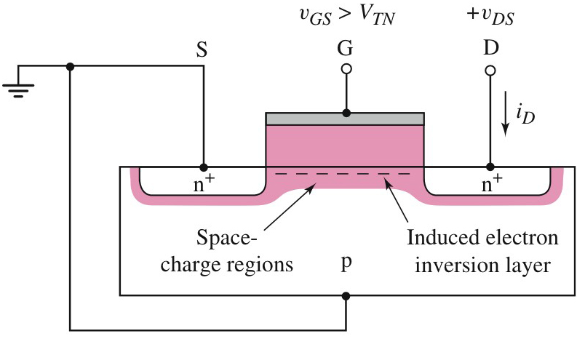
N- type Enhancement MOSFET
If VGS >VTN the channel is formed and a voltage is applied between the drain and the source (VDS), the current will flow.
This current is known as the drain current (i_{D})

Slide 13
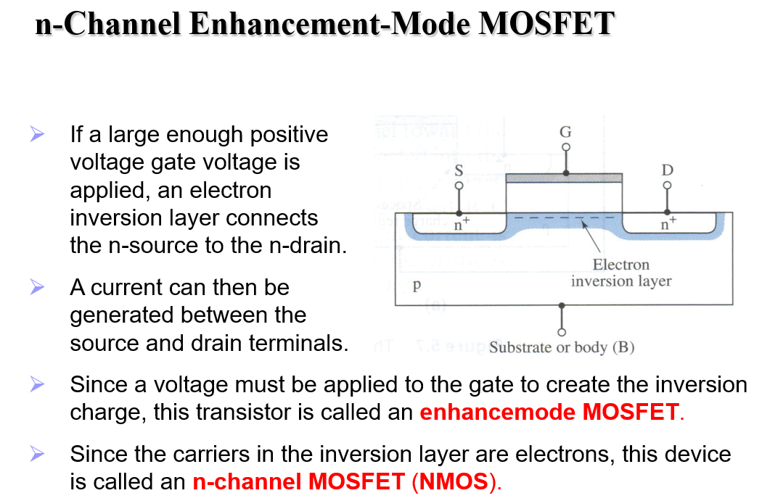

Slide 14
Drain Current in MOS Transistor (ID)
In order for current to flow from the MOS Transistor, a VDS voltage must be applied between the D-S terminals. However, the current is not only a function of the VDS voltage, but also of more VGS voltages.
To obtain the current-voltage relationship, it is necessary to examine the structure of the channel when VDS and VGS voltage are applied simultaneously. In this case, the shape of the channel differs from the previously given smooth structure.

Slide 15
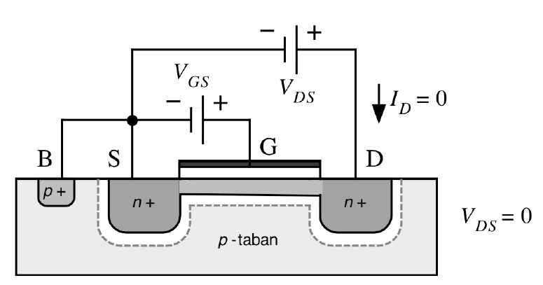
Drain Current in MOS Transistor (ID)
If the VGS voltage applied between gate and source is greater than the voltage of Vth, the channel is formed.
If VDS = 0 at this time, a proper channel is formed, because the voltage between gate and body is the same at every point.
But in this case, since VDS = 0, the ID current is also zero.

Slide 16
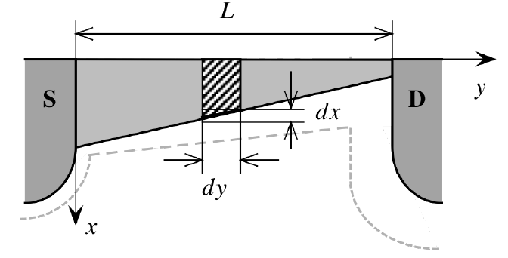
Drain Current in MOS Transistor (ID)
When a positive voltage is applied to the D node of the transistor, while the effective channel voltage at the S node is equal to the VGS voltage, as well as the voltage becomes (VGS –VDS) at D terminal .
If this voltage is still greater than Vth, the channel will be formed and the current will flow.
However, the formed channel is not uniform but wider on the S side and narrower on the D side.

Slide 17
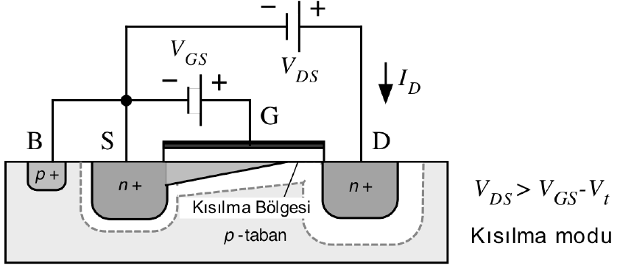
Drain Current in MOS Transistor (ID)
The effective gate-to-channel voltage becomes zero as soon as the VDS voltage rises above the limit value. That is, the depth of the channel drops to zero or, in other words, the channel is reduced.
In this case, drain current only flows through the intersectional surface. The current that this surface can transmit is limited and increasing VDS does not increase the current. Because when the VDS increases, the reduced area gets longer and the resistance increases, whereas the current remains constant as the voltage increases.
As a result, MOS acts as a current source in the saturation region where VDS > (VGS – Vt )

Slide 18
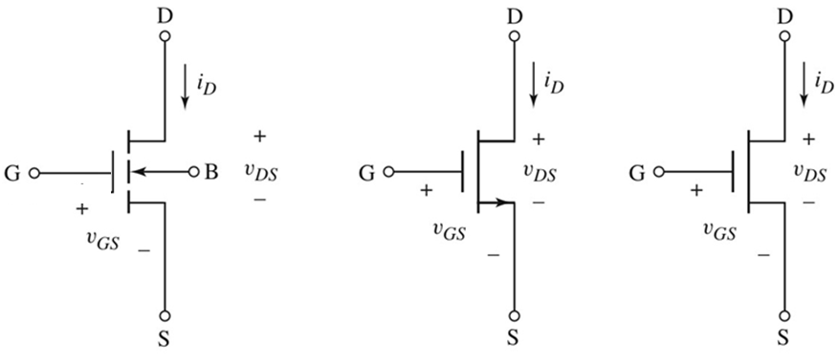
Symbol of N- type Enhancement MOSFET
V_{GS} ≥ 0V, V_{DS} ≥ 0V
V_{TN} positive

Slide 19
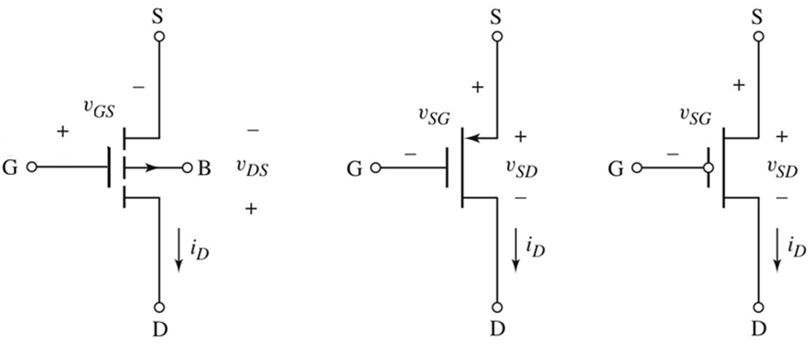
Symbol of P- type Enhancement MOSFET
V_{GS} ≤ 0V, V_{DS} ≤ 0V
V_{TP} negative

Slide 20
ID- VDS Characteristic
The MOS transistor has three operating regions: Cut-off region Triode (Resistance) region Saturation region

Slide 21
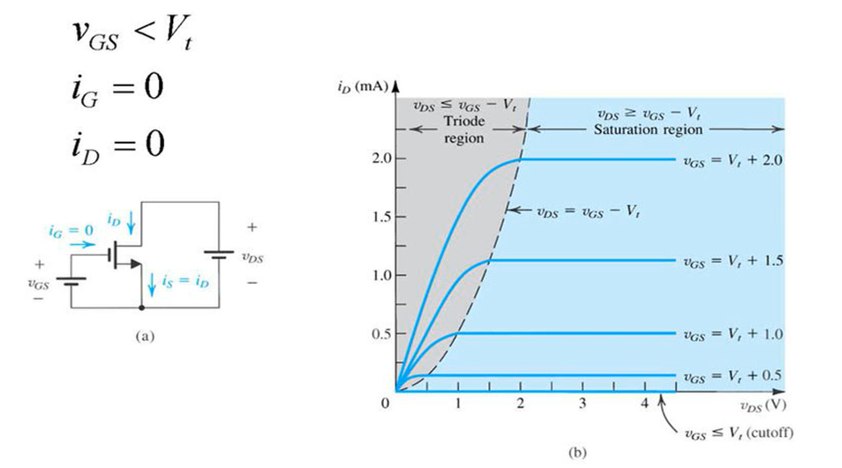
Current-voltage characteristic of N- type Enhancement MOSFET Kesim (Cut off) Region

Slide 22
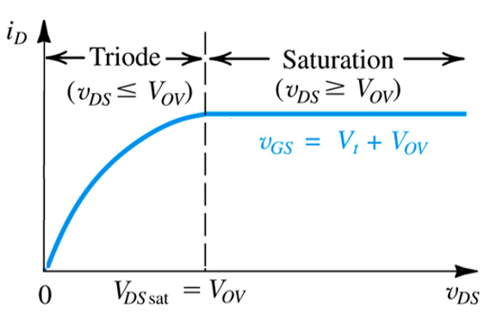
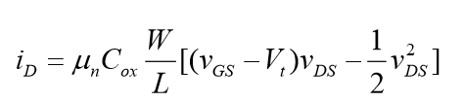
Current-voltage characteristic of N- type Enhancement MOSFET
Direnç Bölgesi (Triode) Region

Slide 23
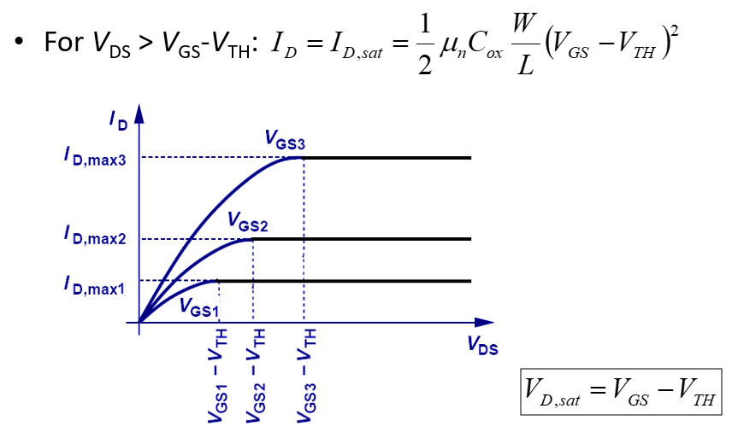
Current-voltage characteristic of N- type Enhancement MOSFET

Slide 24
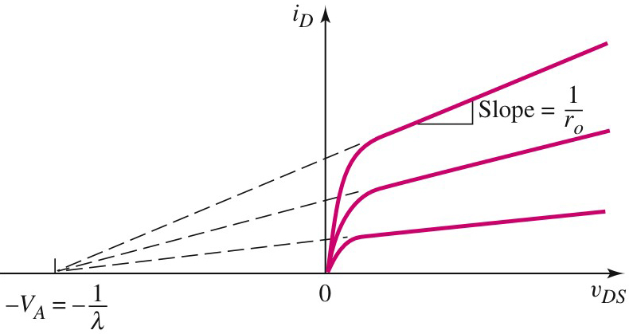
N- type Enhancement MOSFET
Non-ideal current-voltage characteristic
In characteristic curves, extrapolation creates an intersection point in -VA.
λ is the channel-length modulation parameter

Slide 25

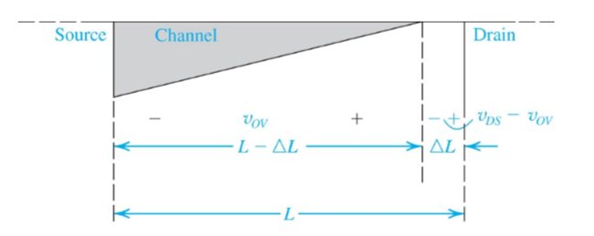

Channel Length Modulation Effect
As the VDS voltage is increased, the pinch point moves slowly towards the Source node. Channel length decreases from L to L-ΔL (This is called channel length modulation λ ).

Slide 26
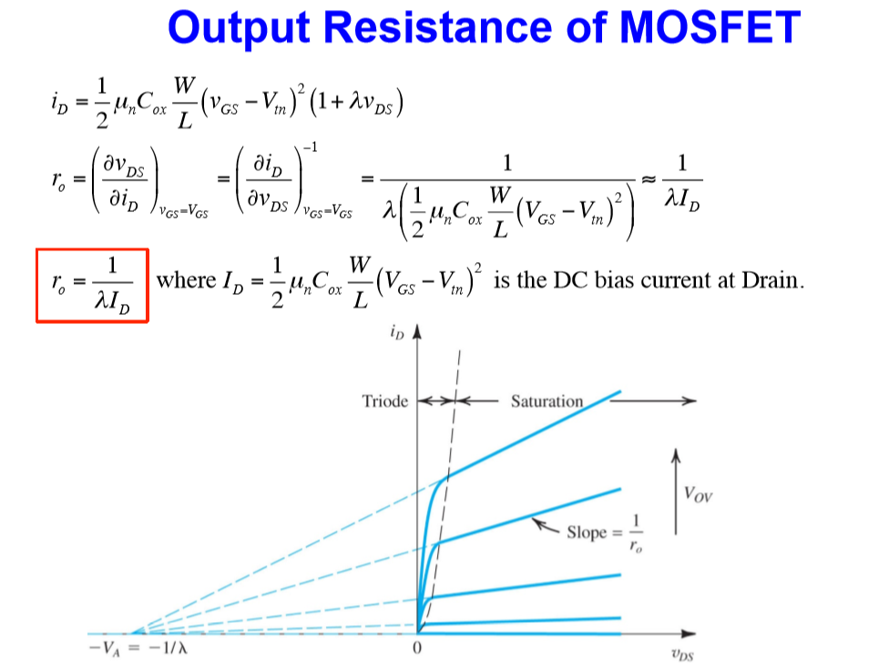

Slide 27
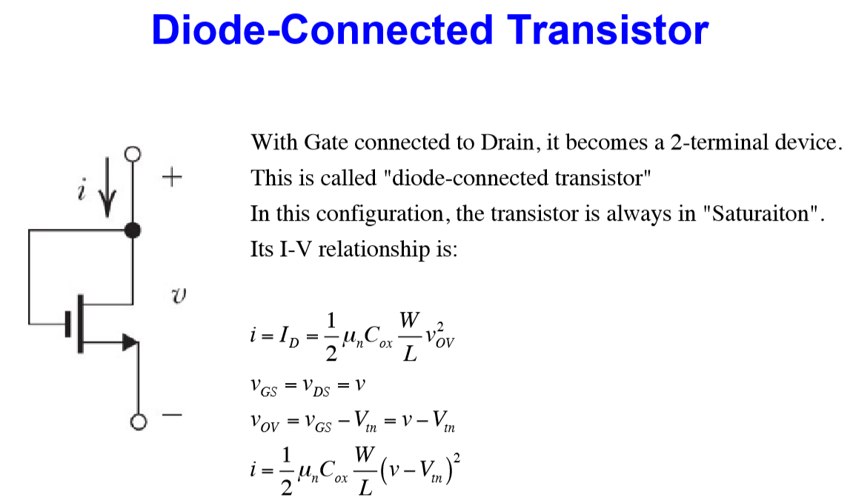

Slide 28
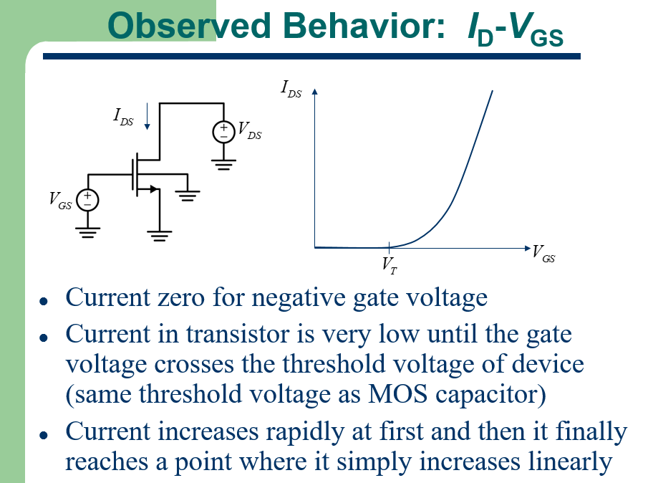

Slide 29
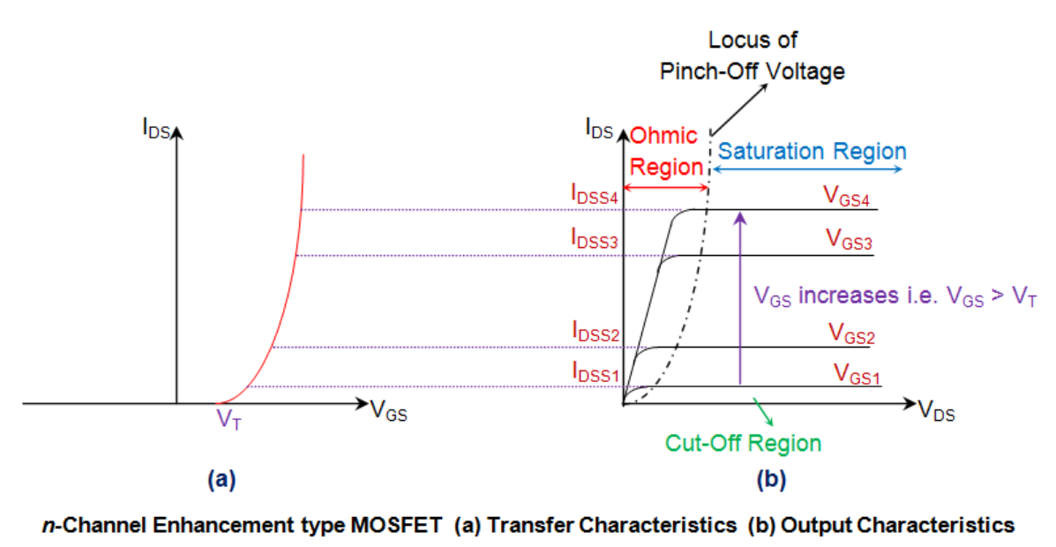

Slide 30
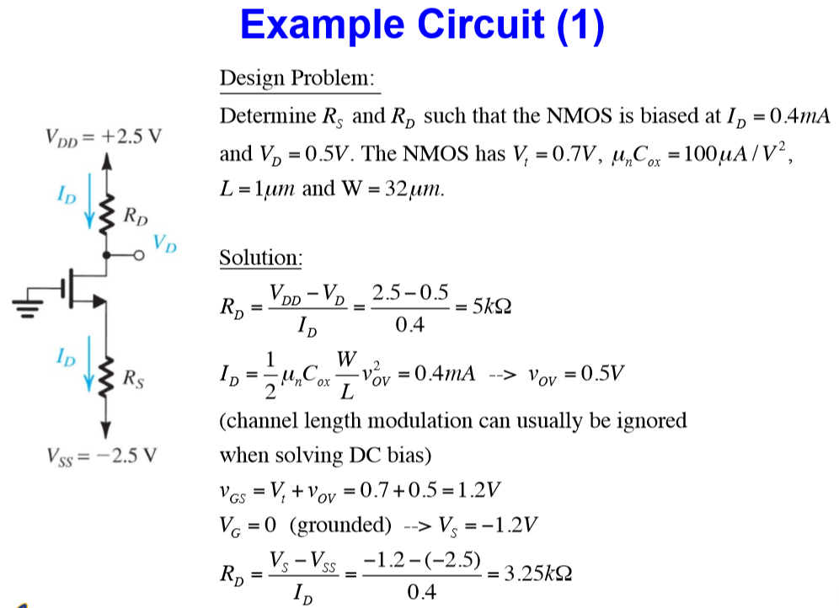

Slide 31
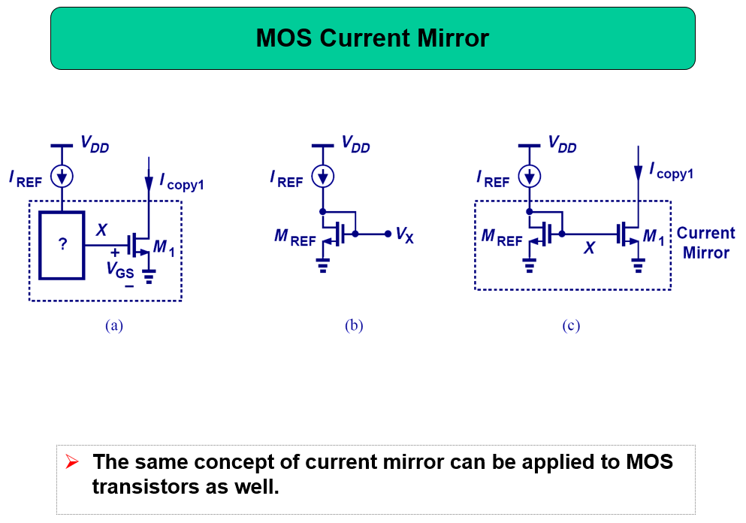

Slide 32
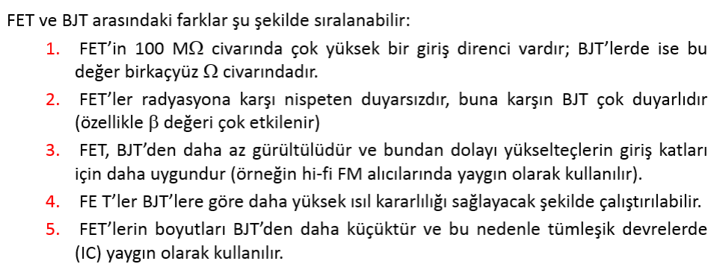
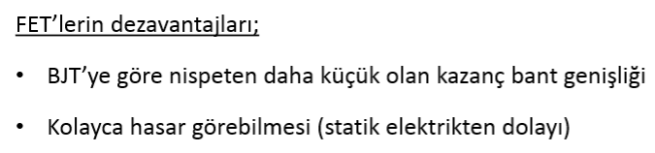
Comparison of BJT and FET

